Slide 2
Enhanced WebAssign
PRESENTER
Getting Started
[Milton Vacon
Executive Sales Consultant]
WebAssign® is a registered trademark of Advanced Instructional Systems, Inc.

Slide 3
Enhanced WebAssign helps students learn, not just do homework.
Unlike homework systems that depend on memorization, Enhanced WebAssign’s educational technology engages instead of drills to elevate thinking and foster a deeper understanding of course concepts to support online math homework, physics homework, and astronomy homework.

Slide 4
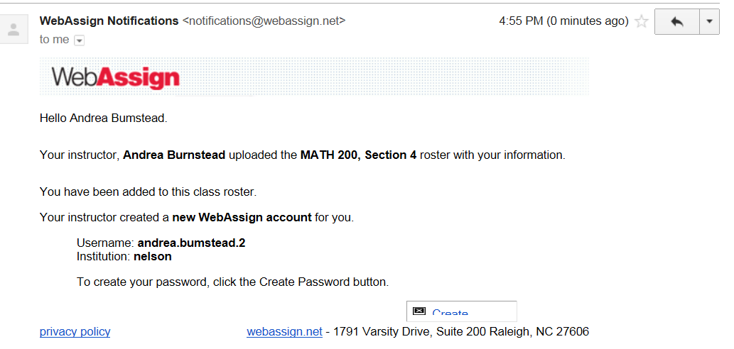
Register/Log In
Go to your Dalhousie e-mail and open the e-mail from ‘WebAssign’
Click on the ‘Create’ button in the e-mail
B

Slide 5
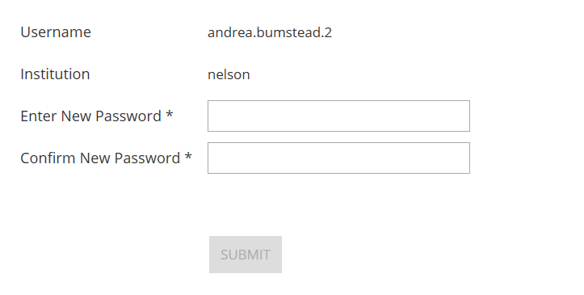
Enter a new password
C. Enter a new password
C

Slide 6
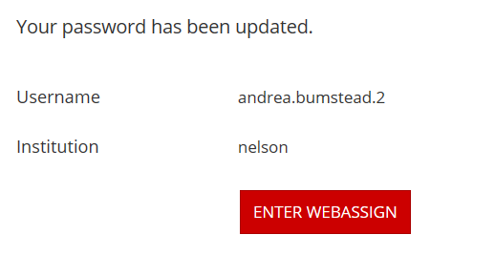
Enter WebAssign
D. Enter WebAssign
D

Slide 7
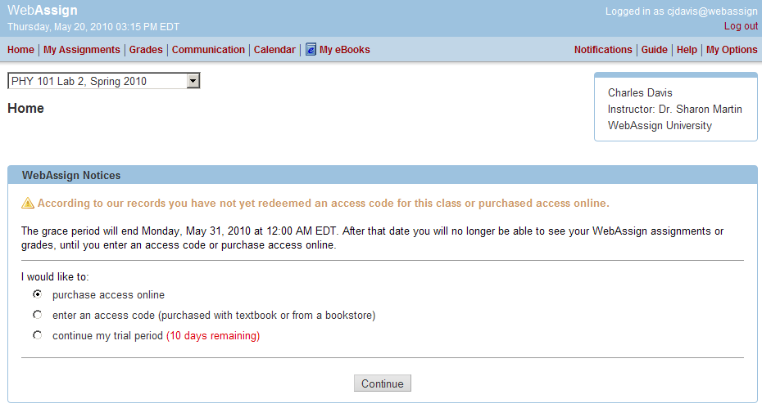
Purchase Access
After logging in, you will see a notice that shows payment options:
If you do not have an access code card: Purchase access online (http://www.nelsonbrain.com/shop/search/9781285858258
B. If you have an access code card: Enter your access code!
Access Code Card
B
You can also enter the course under a trial period. After the trial period ends, you must enter an access code to continue working on assignments and accessing your grades.
Notes:
Your course materials can be purchased at your campus bookstore or by visiting www.cengagebrain.com and searching for your course materials by ISBN.

Slide 8
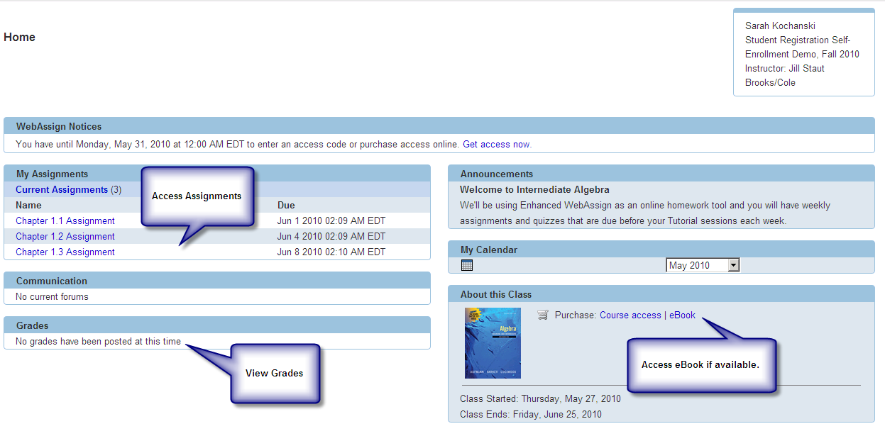
You’re All Set!
That’s it! You’ve successfully registered for Enhanced WebAssign!
The courses that have been set up for you by your instructor(s) appear on your Enhanced WebAssign personalized Home page.
If you have more than one course, simply select the course you want to work with from the pull-down menu.
9
Notes:
9. Click Open next to the name of your course.
That’s it! You’ve successfully registered for Enhanced WebAssign.

Slide 9
Have questions?
Online and after hours:
Check the FAQs in the Support area :
http://www.nelson.com/support
Email:
nelson.brain@nelson.com
Phone Support:
1-800-268-2222
Monday through Friday
8:00am to 6:00pm (EST)
Questions?
We’re Here to Help!
Notes:
If you have any further questions regarding logging in and accessing [insert digital solution] through CengageBrain, please contact us via email or phone using the information shown here.
If you have any questions while using (insert digital solution), please go to www.cengage.com/support and sign in using your cengagebrain credentials. You can then create a case and you’ll receive access to 24/7 live chat or you will have the option to speak to a live agent upon case submission.

